Slide 1
Task 1 - Exploratory testing and bug reporting
Created By:
Prabhudeba Parida
Automation QA Enginer

Slide 2
As part of task-1,I found a production bug in Free Now Application. PFB Bug report.
Bug-1
Title: Destination Input field is taking random routes which are not covered as part of Free-now mobility service.
Description:
Free-Now Application is allowing user to book a ride to any destination across the globe. Observed that User is able to book a cab from one country to another country. The application flow is working the same way as it is working for the Intra city booking.
Environment: Android Version 11-Free now v11.43.0-1829,iOS version 15.5-Free now v11.44.0(4322)
Steps to Reproduce:
1.Launch Free now application on the Mobile Phone.
2.Sign In to your account
3.Click on Book now tile from the home screen.
4.Enter a valid Pick up value from where FREE-NOW service is available.
5.Enter any random place where FREE-NOW service is not available
6.Select the taxi type and Click on Order Taxi now button.
Expected Results:
It should give us a flag that Service is not available for this route while entering the Invalid destination value.
Actual Results:
Application is assigning a driver for this Invalid booking.
Test Data:
Source Destination
Dublin Airport Dubai
Camp Nou,Barcelona Dublin Airport,IRE

Slide 3
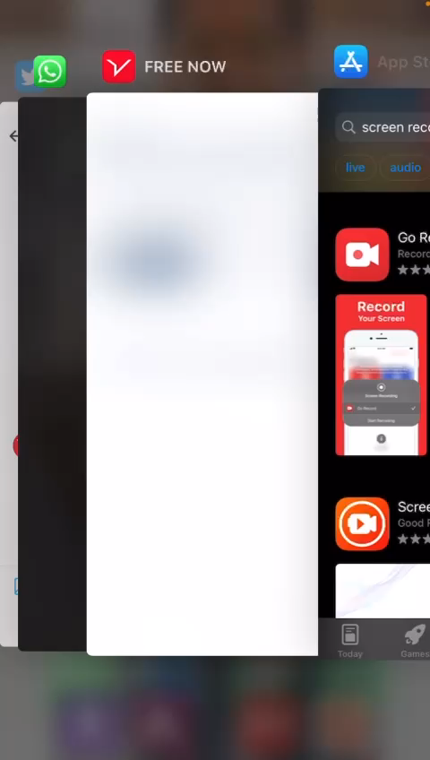
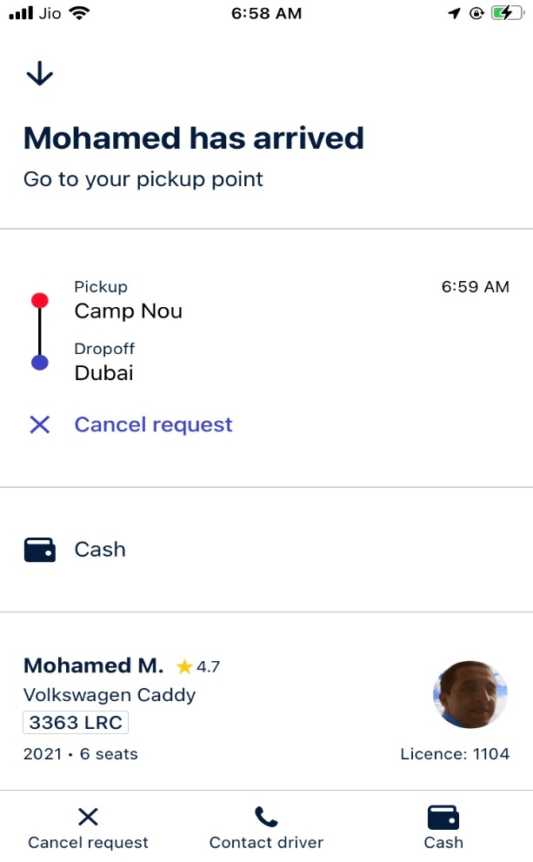
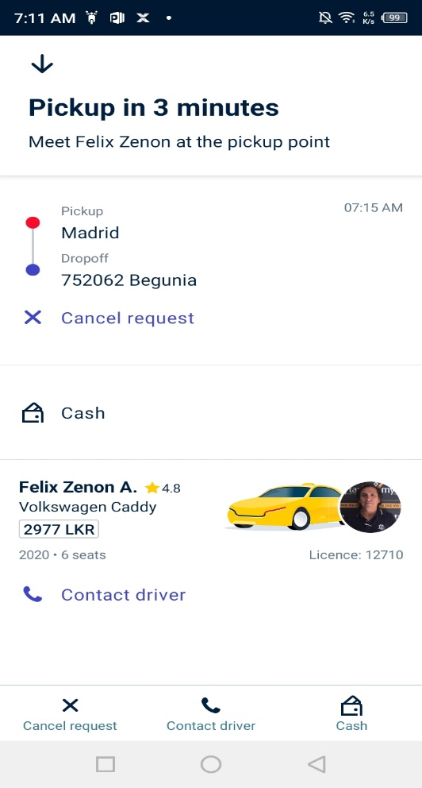
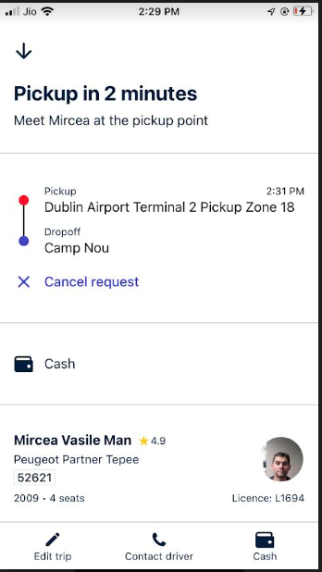
Attachment:

Slide 4
Bug-2
Title: User is allowed to create multiple account using same Mobile Number.
Description:
Free-Now Application is allowing user to free sign up multiple user account with a single Mobile Number. By putting a unique Email, User can create multiple account using a same mobile number.
Environment: Android Version 11-Free now v11.43.0-1829,iOS version 15.5-Free now v11.44.0(4322)
Steps to Reproduce:
1.Launch Free now application on the Mobile Phone.
2.Click on continue with Email
3.Click on Free sign up
4.Enter all details (First name, Last name,Mobile Number,Email,Password)
5.Click on save
6.Enter OTP received on the given Mobile Number.
7.Click on Later or set up the payment and you are ready to use.
8.Sign out and perform the same steps using same test data (except email address) to sign up. By modifying with a new email address(exitent/Non existent) ,User is able to sign up. System accepts all email address and it does not verify whether email address exits or not.
Expected Results:
Application should restrict user to create duplicate account on same mobile number. Since there is no verification process is carried out for email verification.
Actual Results:
User is able to create multiple account same mobile number by just putting a random unique email address.

Slide 5
Business Impact on Bug1:
Since it is allowing to put any random location across the globe to place an booking. Free now does not check the destination value whether it is coming under serviceable area or not. It will create a confusion between user and driver. Observed that Drivers are also not cross checking the destination value before accepting the ride. Drivers are spending pick up time and pick up distance unnecessarily for an unserviceable trip.
We should restrict the destination value which are serviceable from source/pick up location.
Business Impact on Bug2:
Since Application is allowing to create multiple accounts on a single phone number just by updating the email address(which is also not verified via OTP to avoid non existent email address).Thus it will help user to switch to different account incase user has been charged with any cancellation charge or anything else.
To avoid such circumstances ,Free now should restrict the user to create one account per Mobile number and per email address.

